Slide 1
CAN 1000bps
Battery
Module
BCM
X357
MOSFETs
Contactors
High Voltage
X358
CAN 500bps
USB
HVJB
Laptop
Charger
CAN Sender
Proximity
USB
Pilot
AC Voltage
J1772
USB
GND
D1 = 12v
Power = 12v

Slide 2
2014 Spark EV A123
Battery Module
Contactors
Perm 12v 10A
Fault 13
X357
X358
1-HOT
9 10 4 14 3
9 8 7 10
GND
GND
Ignition
K1 Pre-Charge
Flyback
Diodes
Acc Wakeup
MultiFunct
K3 Main -VE
K2 Main +VE
Ignition 12v 5A
HV Coms Enable
12v 10A
RELAY BANK
-6 6
-5 5
-4 4
-3 3
-2 2
-1 +1
GND
GND
JD-VCC
VCC P6 P5 P4 P3 P2 P1
5v ?A
Opto
Isolator
CAN 1000bps
8
7
GND
6
5
4
12
BCM (Mega)
+5v
2
52
3
TesLorean
CANbus
L
H
Battery
CANbus
51
INT
SCK
SI
SO
CS
GND
VCC
White
Blue
INT
SCK
SI
SO
CS
GND
VCC
50
H
CAN 500bps
10
9
L
11
VCC
PWMs
Notes:
X357 pins 1conflicting information
#define Relay_X357_4 7 // X357-3 to 12v accessory wake up
#define Relay_X357_5 8 // X357-14 to 12v HV energy mgt communication enable
X357 separate 12v required apart from pin X357_4? (or _3)
X358 has a separate Hot/Gnd ???
X358 conflict – feed by pin 3 which is also interrupt for TesLCANBus

Slide 3
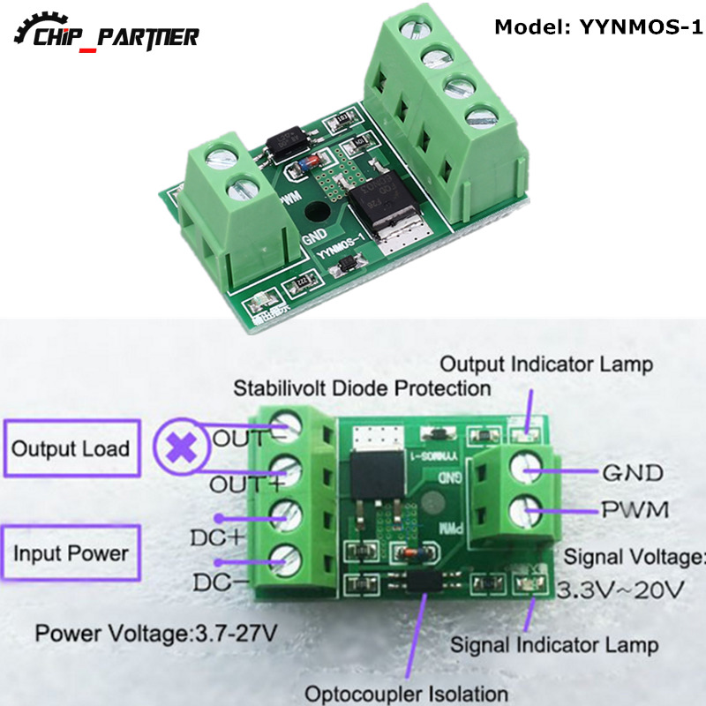

Slide 4
